Slide 1
The Most Important Data Structures in Python
By: Iman Khani Jazani
Senior Data Scientist, Community builder | Adin
AI and Data Specialist, Business Developer | AiHum
Adjunct Professor | Sharif University of Technology

Slide 2
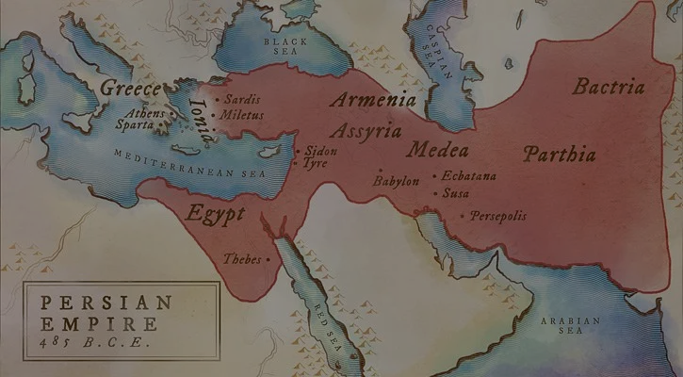
امیدوارم امسال سالی باشه که تووش یه عالمه موفقیت براتون رقم بخوره و کلی دلتون شاد باشه و من هم از شادیتون لذت ببرم و امیدوارم امسال باعث خوشحالی دل خودتون و بقیه باشین...
دوستتون دارم، ایمان
14/1/1402

Slide 3
Last lecture
Short Presentation
Review the Last Lecture
What is data structure?
For today: lists, nested lists (nested things), and tuples
Can we create a new data structure?
Programming with Python IDLE
Application of Programming in the Digital Age!

Slide 4
Today
Short Presentation
What is data structure?
For today: dictionary, set, nested of all things
Programming with Python IDLE
Application of Programming in the Digital Age!

Slide 5
Together
Send your feedback about the class whenever you want!

Slide 6

Contact me
Gmail: ImanKhaniJazani@gmail.com
LinkedIn: https://www.linkedin.com/in/ImanKhaniJazani/
Telegram: @IKJ1992

Slide 7
Short Presentations

Slide 8
Review the Last Lecture

Slide 9
Steps to Done your final project!
Team building
Hard skill
Soft skill
Searching and finding a great question!
Team-working for proposal writing
1-3 pages document
Problem definition and suggestion for real solution
Operational plan (time and responsibilities)
Proposal Evaluation!
Team-working for coding and development
Git and Github for code sharing
Discord for team management
Technical Evaluation!
Your score

Slide 10
What is Data Structure?

Slide 11
Definition
An organization of data for the purpose of making it easier to use.
Algorithm
Data Structure
Program

Slide 12
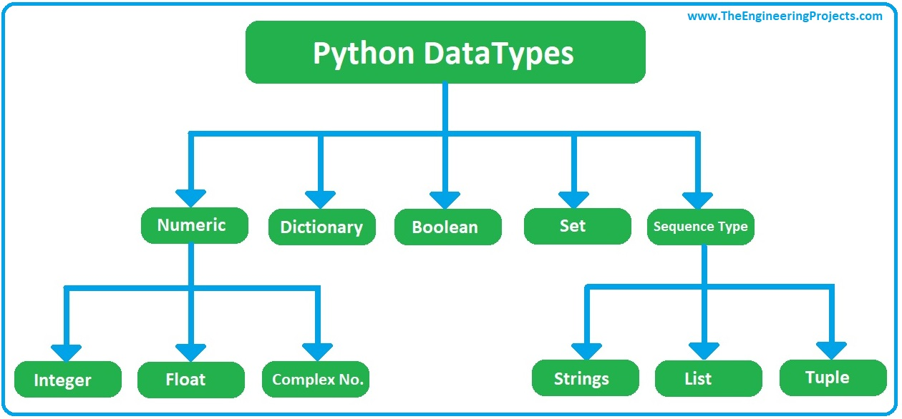
Python DataTypes

Slide 13
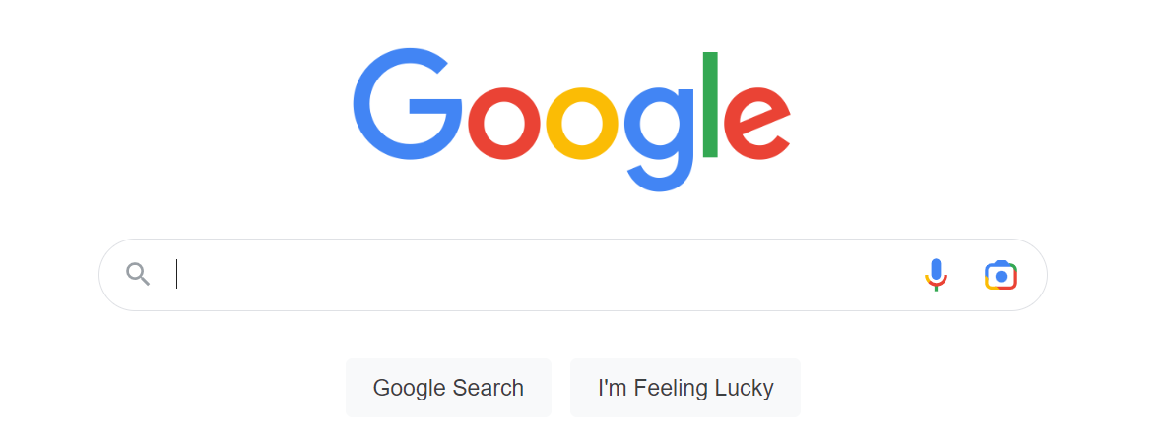
Dictionary

Slide 14
Set

Slide 15
Nesteds!
List of dict
Dict of list
Tuple of dict
Tuple of dict of list
List of list of list of list
…

Slide 16
Programming with Python IDLE

Slide 17
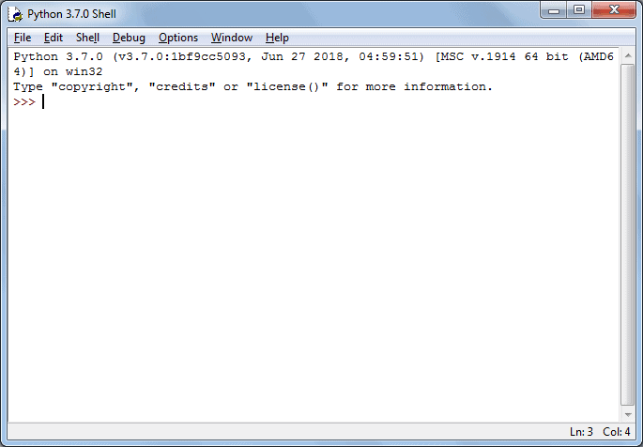
Let’s go for prompt-based coding…

Slide 18
Application of Programming in the Digital Age!

Slide 19
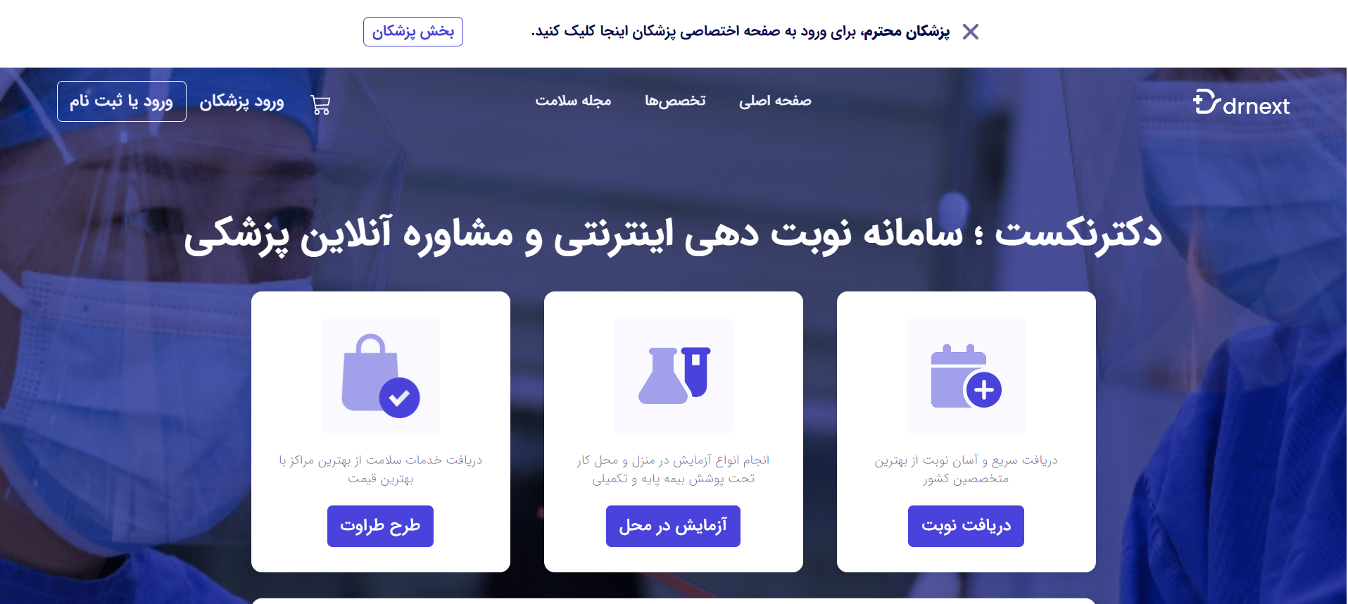
Drnext

Slide 20

Programming a simple DrNext!
ثبت و ویرایش بیمار
ثبت و ویرایش مرکز درمانی
جستجوی بیمار بر اساس نامش
جستجوی بیمار بر اساس مشخصات
جستجوی مرکز درمانی بر اساس نامش
جستجوی مرکز درمانی بر اساس مشخصات
نوبت‌دهی بیمار بر اساس مرکز درمانی انتخاب شده توسط بیمار
...
Notes:
Problem definition and step by step solving…
Modular structure of our project trying to comment our code! Nested (dict of list)
Working with strings
Break and continue
Functions with return statement
Do you have any idea to make a better DrNext?

Slide 21
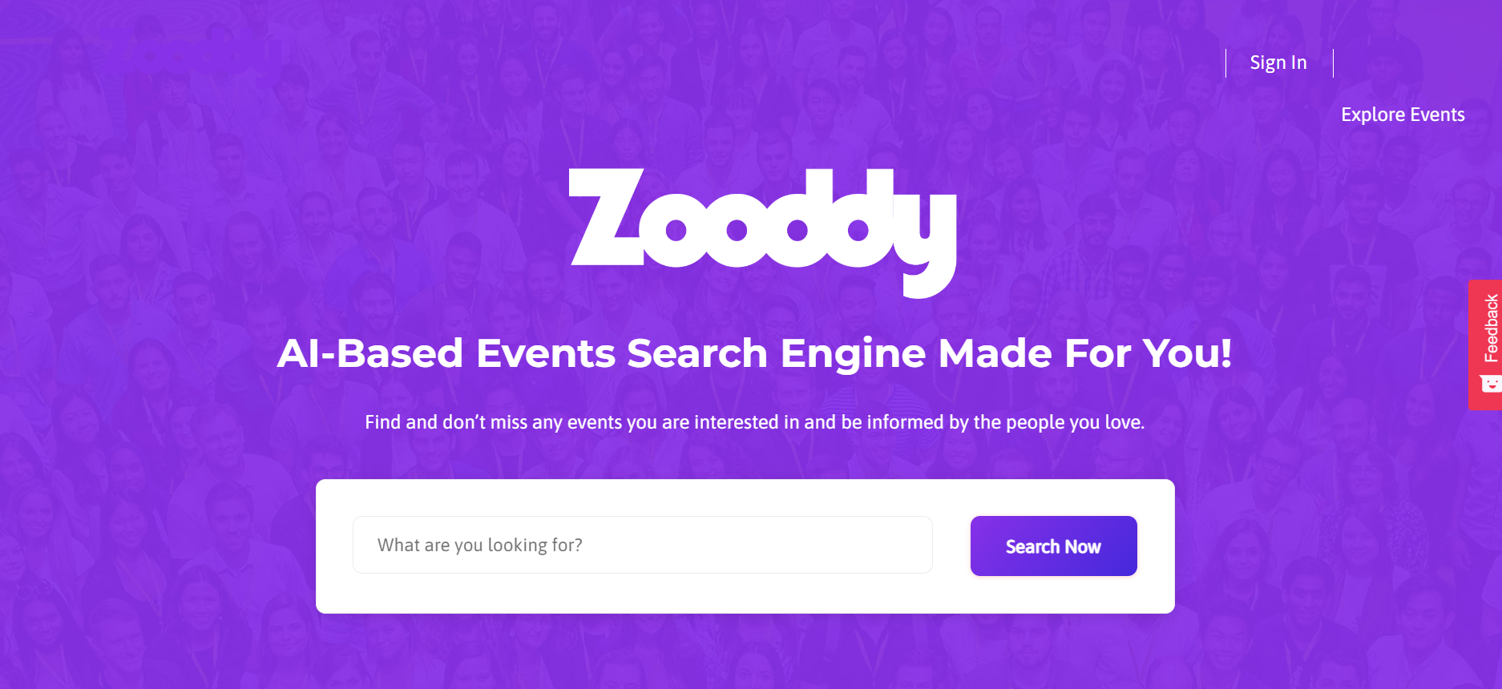
Can you implement simple Zooddy for short presentation? Transform your flowchart to Python code!

Slide 22
Lecture Resources
P. Wentworth, J. Elkner, A. B. Downey, C. Meyers. How to Think Like a Computer Scientist: Learning with Python. 3rd Edition, Open Book Project, 2011.

